Slide 1
Heart disease data

Slide 2
Introduction
Heart disease refers to any problem affecting the heart, such as coronary artery disease, arrhythmia, and heart failure.

Slide 3
Details of Data
The dataset has no missing values and contains a variety of numerical attributes. Here are some key observations from the summary statistics:
The average age of the patients is around 54 years.
The majority of the patients are male (about 69.6%).
The dataset contains various attributes that measure different aspects of heart health, such as chest pain type (cp), resting blood pressure (trestbps), cholesterol levels (chol), maximum heart rate achieved (thalach), and others.
The target variable indicates whether a patient has heart disease (1 = yes, 0 = no), with roughly equal distribution.

Slide 4
Main KPIs
Age distribution of patients
Gender distribution of patients
Heart disease diagnosis

Slide 5
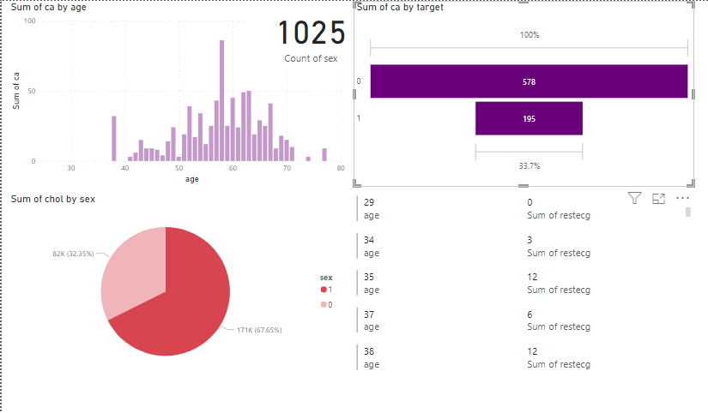
Dashboard

Slide 6
Thank you

